Slide 1
BNP Paribas Fortis
28/04/2022
A Look at Services

Slide 2
The Presenter
Peter De Kinder
Solution Architect.
Consultant since 2001
Architectural Solutions
Integrations
Addressing initiatives within organisations with a complete solution.
Letting all individual parts of the architectural solutions communicate with each other.
Business Processes
Security
Automating and optimizing the business processes within an organization
Making sure that all parts of the architecture heed the proper security requirements.

Slide 3
Agenda
A
Introduction
Presenting the speaker
B
Services
What are they? What do they consist of?
C
Architecture & Use
How and where to use them.
D
What about the hardware?
What you need to run these services.

Slide 4
Agenda
A
Introduction
Presenting the speaker
B
Services
What are they? What do they consist of?
C
Architecture & Use
How and where to use them.
D
What about the hardware?
What you need to run these services.

Slide 5
Definition of a Service
Services are a set of technologies and rules that
enable two or more components to talk to each other.
A Web service is nothing more than a
service that performs this function of the
“internet”.
Services
Distributed Code Execution
Allow components across the web to communicate with each other
Addresses a business/technical need
Supporting better User Experience

Slide 6
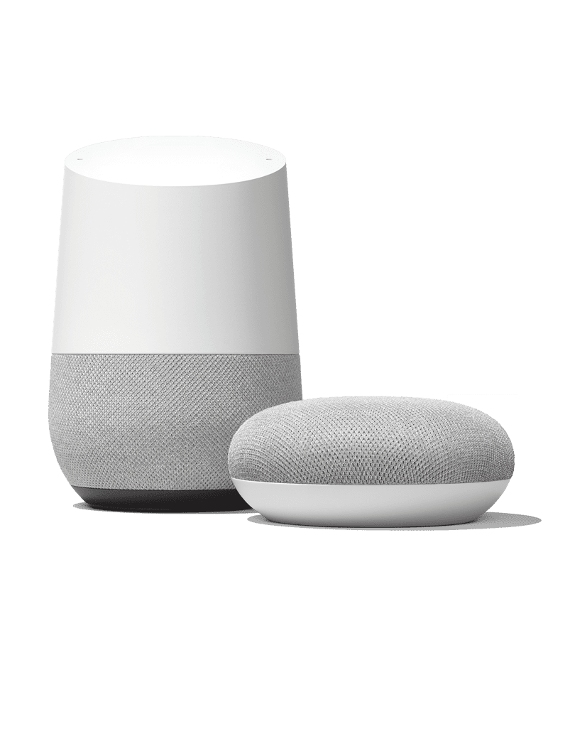
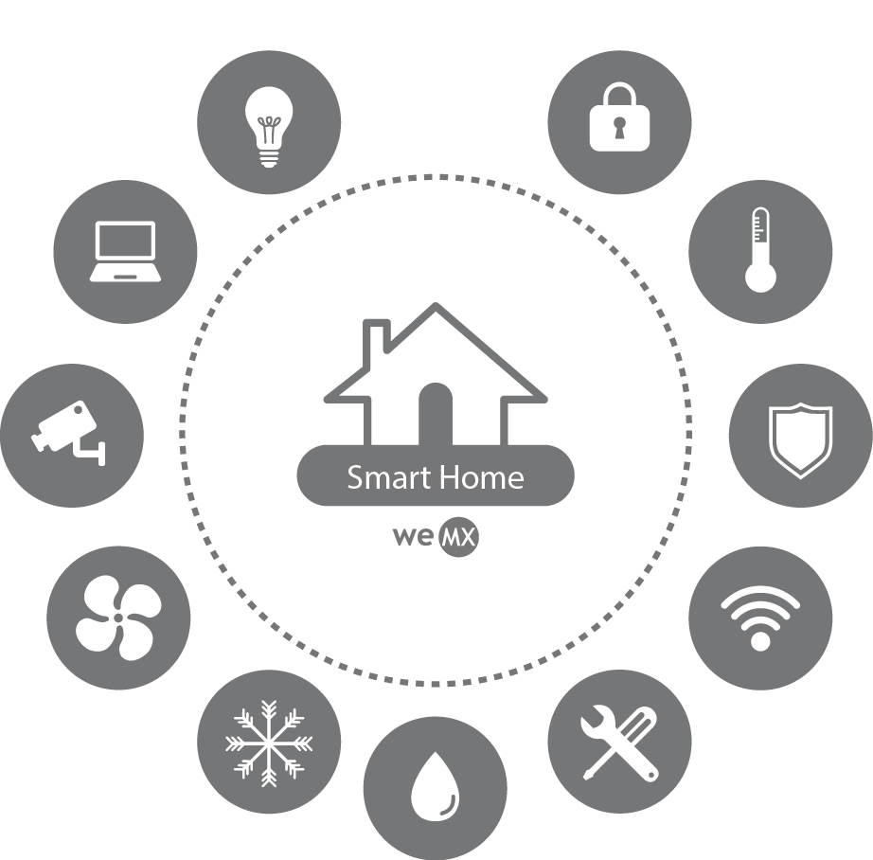
Conversational Interfaces
Web Pages
Internet-of-Things
Making sure there is always someone to talk to.
Visualising information to a user.
Exchanging information to your house appliances
Mobile Apps
Coming to a phone near you!
Notes:
Why do we do web services:
Easier exchange of data
Reduction of development & maintenance time

Slide 7
Structure of a Service
Service Contract
This is the structure of the information that can be exchanged between services. The syntax as it were.
Security Identities
You can simply impress your audience and add a unique zing and appeal to your Presentations.
Implementation
The lines of code that make up the technical and business logic of the service
Services
Service Endpoint
The location in the digital world where this service can be found.
Payload
The actual information transferred between services.

Slide 8
Real Life Similarities
Notes:
Services are like people talking!
The flesh and blood person is the implementation of the service
The language is the interface
Contract is the list of agreed upon talking points for the conversation
The endpoint is the chair the person is sitting on.
The spoken words are the payload
Security identities are the people recognizing each other based on introductions or previous encounters
Table is the infrastructure where the services are deployed
Canocical data model is like a dialect of the chose language!

Slide 9
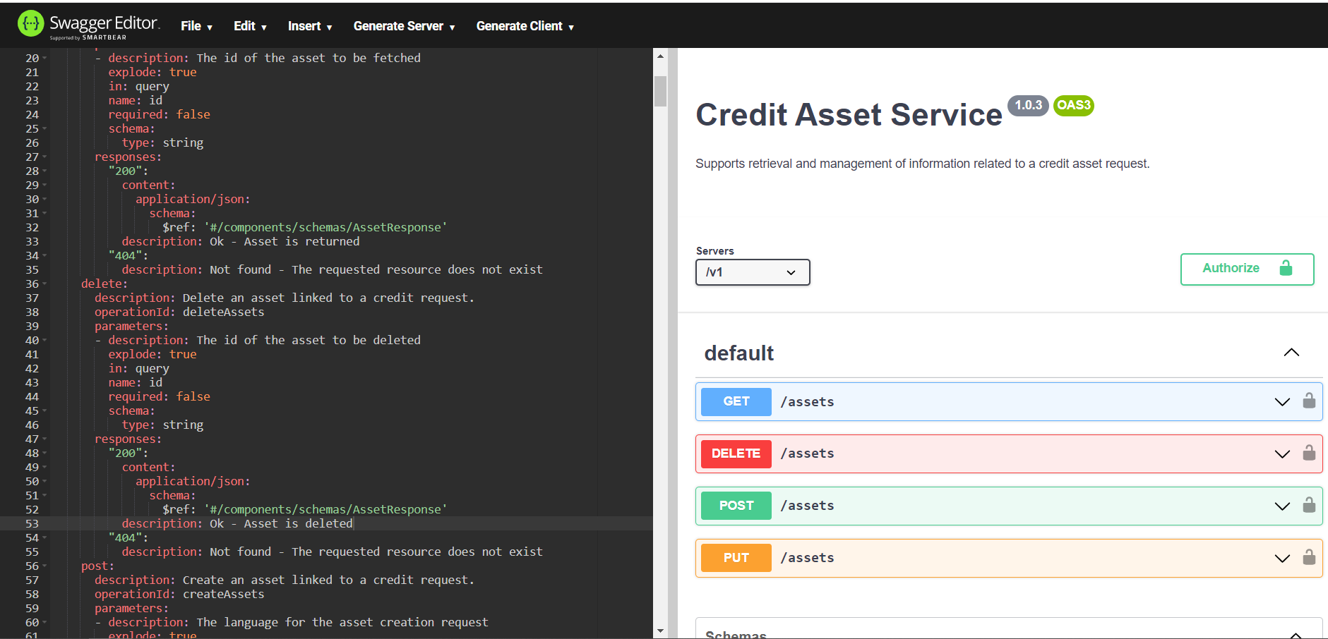
Service Contracts
Notes:
Other possibilities:
Protobuf
Spring REST Docs
...

Slide 10
Agenda
A
Introduction
Presenting the speaker
B
Services
What are they? What do they consist of?
C
Architecture & Use
How and where to use them.
D
What about the hardware?
What you need to run these services.

Slide 11
Evolution of Services
1981
1998
2007
2012
2016
Remote Procedure Calls
SOA
Microservices
GraphQL
gRPC
First Real Distributed Computing Model
Web Services (SOAP) become very present in the IT landscape
Born from the concerns about SOA, and based on REST
Singular endpoints with sql-like interface
Google’s way of looking at distributed computing
Notes:
Client server -> rpc -> soap -> rest -> graphql -> gRPC -> ?

Slide 12
Tradeoffs
Reusability
Maximizes Technical reusability.
Strong Governance
More visibility on how the services are used.
Microservices
Structured per Technical Purpose
Layered approach to services
Canonical Data Model
A data model shared by the entire organization
Reusability
Maximizes Functional Reusability
Increased Agility
Classic SOA
Easier to change
Structured per Business Domain
Bounded Contexts
Domain Data Models
Shared Models per Domain
Notes:
Pros and contras
Decoupe in layers
Decoupe in functional domains
Adapters!
EDM

Slide 13
Reducing the Monoliths
Reality in Most Organisations
Strangulation
Cutting out isolated pieces of logic and expose them as services
Master/Slave Relationship
Ease of transition by constructing master/slave structures in the information assets
...
Multiple other ways to go about this.

Slide 14
Process Automation
Simulate a Loan
Prepare Loan Evaluation
Evaluate Loan Application
Loan Realization
Loan Signing
Insert Repayment Tables
Fetch Notary List
(FedNot)
Credit Risk Assessment
Encrypt Signed Documents
Payment Check (recurring)

Slide 15
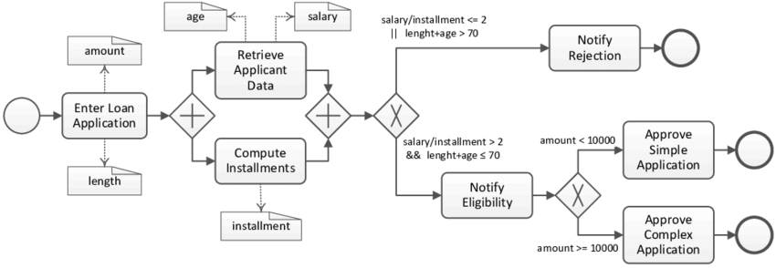
Process Automation

Slide 16
Agenda
A
Introduction
Presenting the speaker
B
Services
What are they? What do they consist of?
C
Architecture & Use
How and where to use them.
D
What about the hardware?
What you need to run these services.

Slide 17
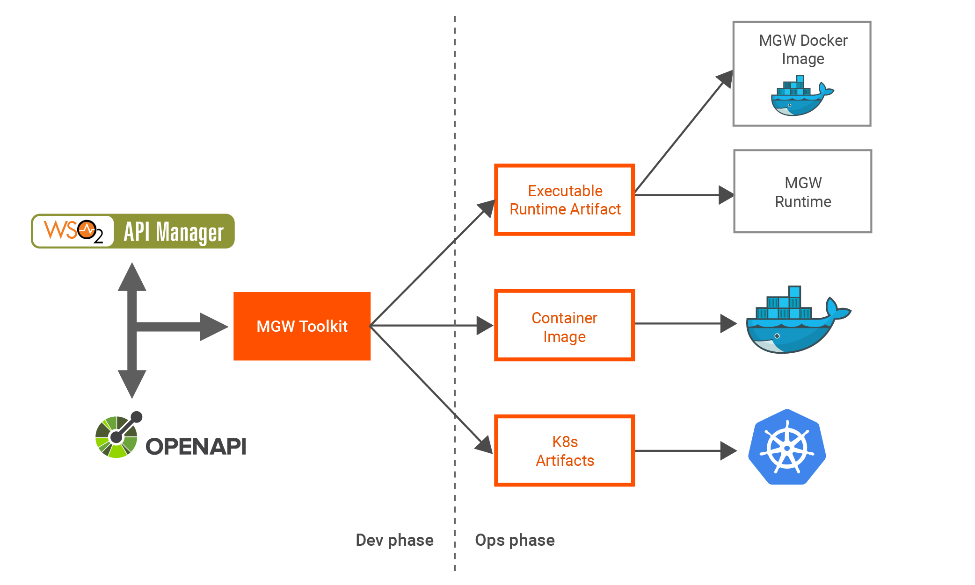
API Gateway vs ESB
Notes:
An API gateway acts as a reverse proxy to accept all application programming interface (API) calls, aggregate the various services required to fulfill them, and return the appropriate result.
You want to protect your APIs from overuse and abuse, so you use an authentication service and rate limiting.
You want to understand how people use your APIs, so you’ve added analytics and monitoring tools.
If you have monetized APIs, you’ll want to connect to a billing system.
You may have adopted a microservices architecture, in which case a single request could require calls to dozens of distinct applications.
Over time you’ll add some new API services and retire others, but your clients will still want to find all your services in the same place.

Slide 18
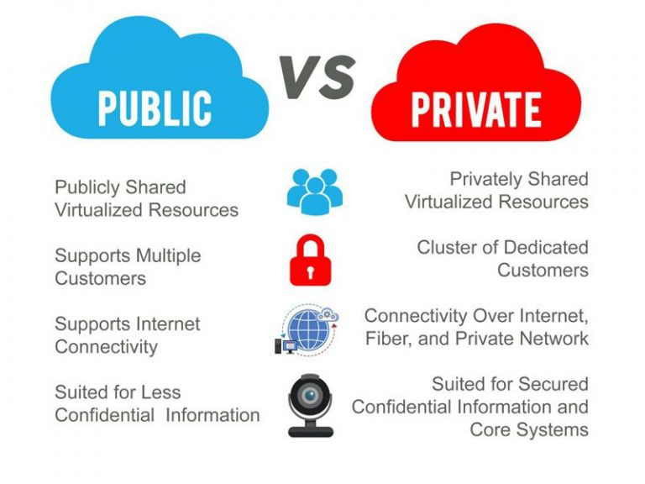
Service Locations

Slide 19
Questions?

Slide 20
Thank you for your Attention

